Slide 1
Focusing on the XY data for sports
Anson Wong

Slide 2
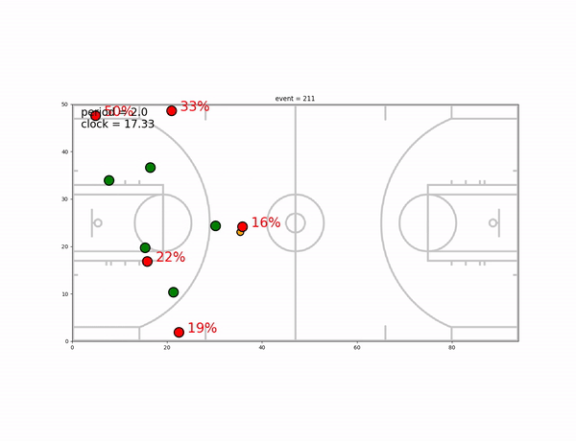
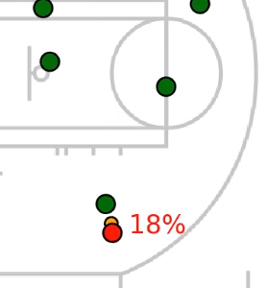
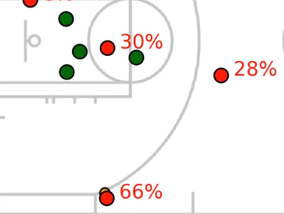
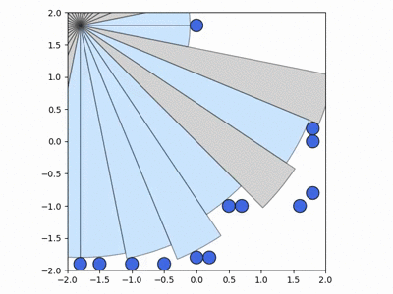
What I am doing these days
Shot-quality model (uses XY data)
2) Agent-model to generate XY game strategies
good shot
bad shot
Learn to develop strategies with a computer automatically!

Slide 3
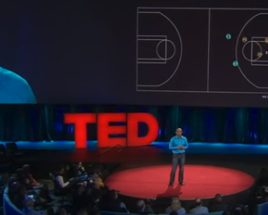
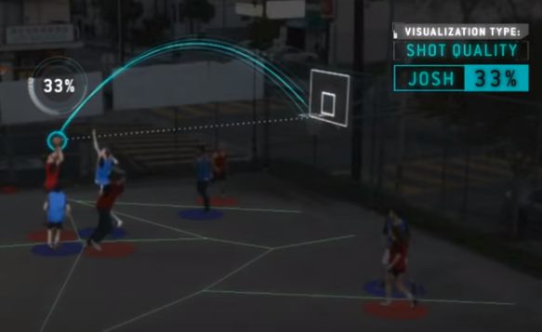
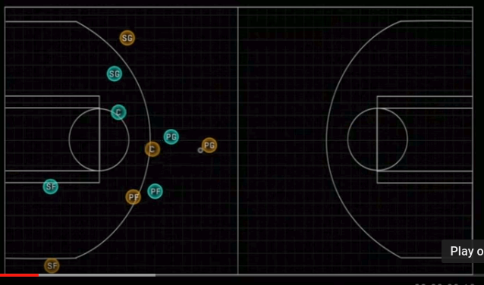
TED talk (July 2015) about state-of-the-art NBA analytics
Obtain a measure of ‘shot quality’

Slide 4
What I built: a shot-quality automator
The XY data of an Atlanta vs Detroit NBA game
The % represent shot-quality here

Slide 5
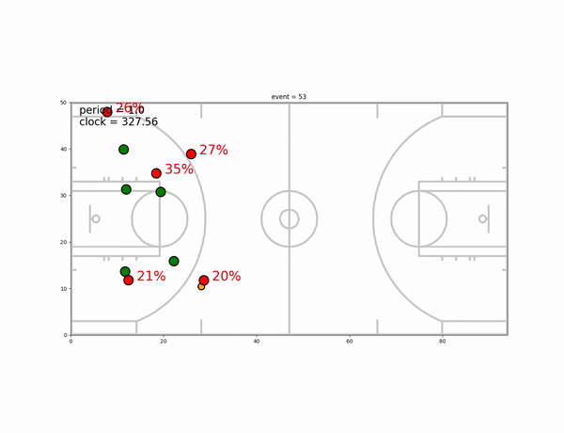
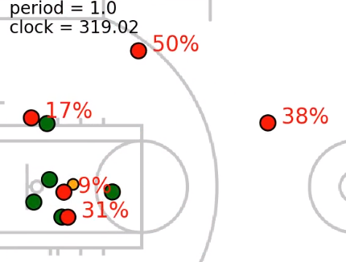
What I built: a shot-quality automator
Using XY + play-by-play data
-> our player shot quality
Shot % based on defense + shot distance
Were there better options???...

Slide 6
More about our shot-quality model:
Can be upgrade to be more player-specific (i.e. good/bad shooters and defences)
Define a “defensive” metric for players or formations
Automatically spot missed opportunities to help correct players
Real-time shot analysis: we can say quickly tell you which plays were historically advantageous and disadvantageous

Slide 7
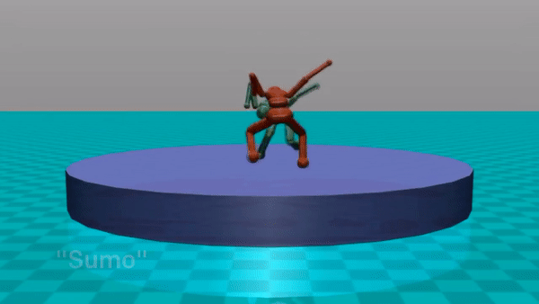
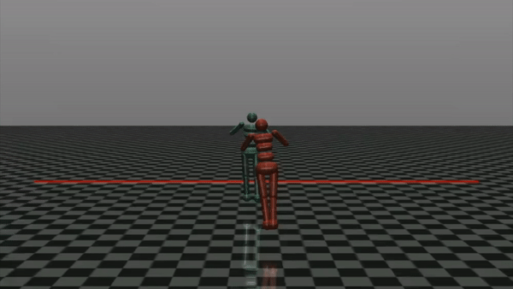
But can we do more with XY models?
Let’s look at what’s out there:
OpenAI’s “Emergent Complexity via Multi-agent cooperation” paper
Self-play -> Sumo/soccer Run past someone

Slide 8
But can we do more?
So the idea I had was to combine:
i) Self-play and deep reinforcement learning
ii) Common rewards/rules of sports games
iii) Actual XY data from sports matches
----> build a model that generates “optimal” strategies to win your game, and a way to evaluate player decisions (did they make the “right” play?)
------> XY Universe!!!

Slide 9
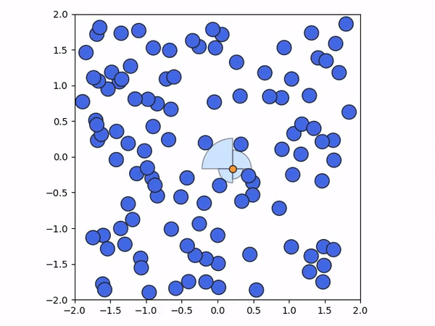
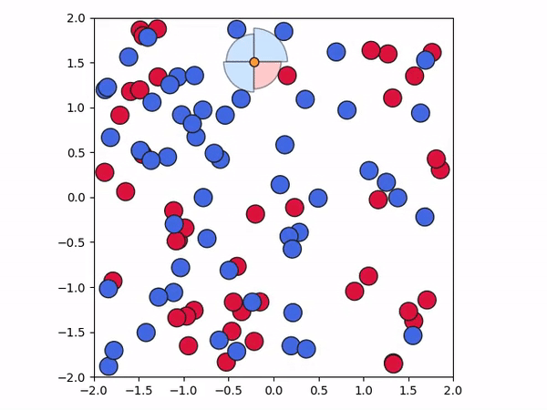
XY Universe: 2D particle strategies
Start by building the basics:
Avoid bad particles and eat good particles
Avoid bad particles

Slide 10
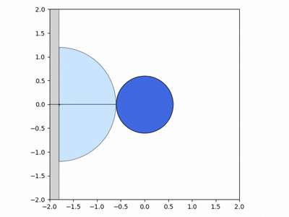
XY Universe: 2D particle strategies
Then a little more-specific...
Avoid bad particle and get to the right asap
Avoid bad particles and get to the right asap

Slide 11
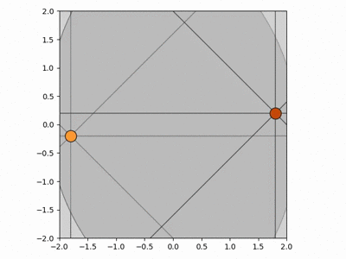
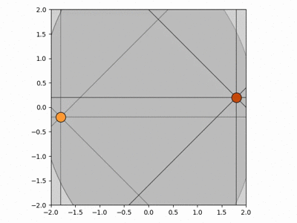
XY Universe: 2D particle strategies
Now add in some competitive self-play...
Get to your goal (early stages)
Get to your goal (late stages)

Slide 12
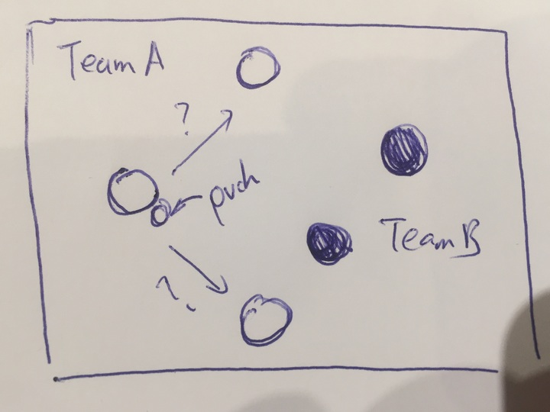
XY Universe: 2D particle strategies
What’s in the future?…
-> add more complexity, more agents + passing
What this all means:
Find strategies and formations based on weaknesses of opponents
Study tendencies
Correct bad habits of players
Evaluate player skill for trades/draft
future

